Slide 1
Factoring Quadratics when a=1
Factoring Quadratics when a>1
Solving Quadratic Equations by Factoring
Factoring Polynomials Using GCF
Factoring difference of squares polynomials
Factoring by grouping with 4 term polynomials
Math III

Slide 2
1. Factoring Quadratics when a=1

Slide 3
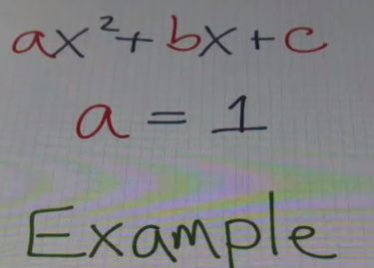

Slide 5
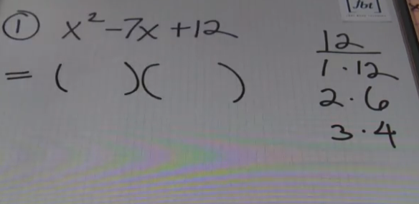

Slide 6
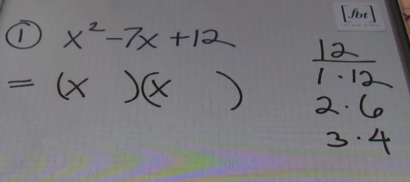

Slide 7
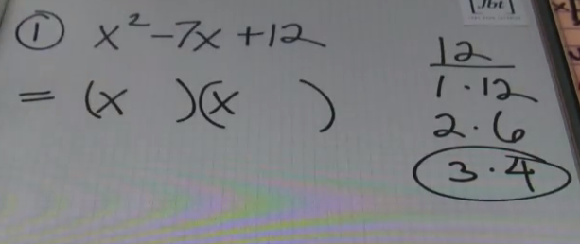

Slide 8
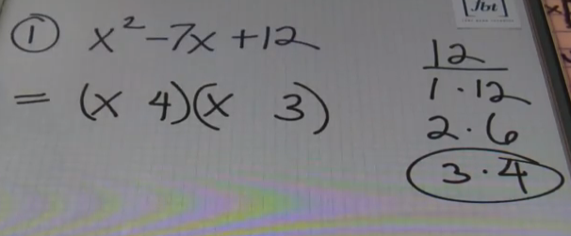

Slide 9
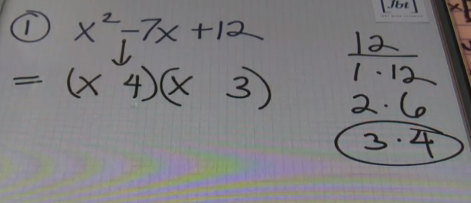

Slide 10
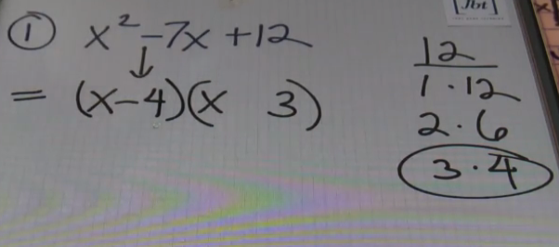

Slide 11
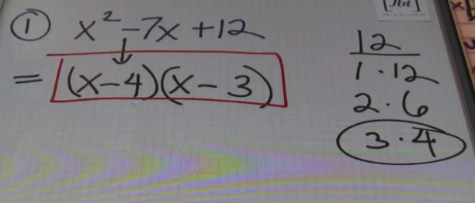

Slide 13
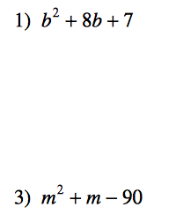
Factor the following quadratics:

Slide 14
2. Factoring Quadratics when a>1

Slide 15
The standard form of a quadratic is ax² + bx + c
For this quadratic what is a?
So a is greater than 1. (a>1)
Here is a simple way to factor a quadratic when a is greater than 1. (a>1)

Slide 16
a = 6 b = 7 c = -3
Replace c with a times c (ac)

Slide 17
Factor the new quadratic by finding two numbers that multiply to be the new c, and add to be b.

Slide 18
Divide the 2 numbers by a
Notes:
Divide by a

Slide 19
Simplify

Slide 20
Move what ever is in the denominators to the front of the set of parentheses

Slide 21
Finish Factoring

Slide 22
Check work

Slide 23
Factor the following quadratics:

Slide 24
3. Solving Quadratic Equations by Factoring and using Zero-Product Property

Slide 25
Solving Quadratic Equations by Factoring Step 1 – Put the quadratic in standard ax²+bx+c form Step 2 – Factor the quadratic using any method Step 3 – Set factors equal to 0 (Zero Product Property) Step 4 – Solve for x and those are your solutions

Slide 26
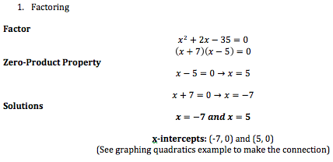

Slide 27
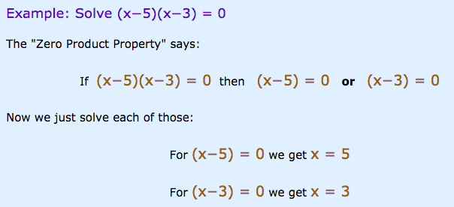

Slide 28
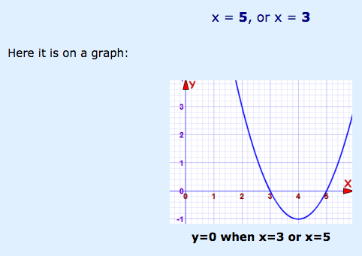

Slide 29
Use the zero-product property to find the solutions to the following quadratic equation:

Slide 30
Use the zero-product property to find the solutions to the following quadratic equation:

Slide 31
Use the zero-product property to find the solutions to the following quadratic equation:

Slide 32
Factor and use the zero-product property to find the solutions to the following quadratic equation:

Slide 33
Factor and use the zero-product property to find the solutions to the following quadratic equation:

Slide 34
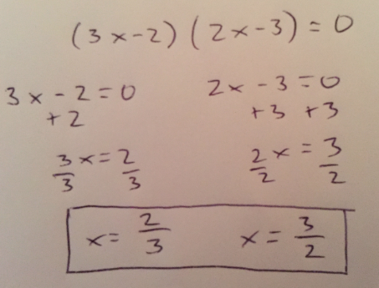
Factor and use the zero-product property to find the solutions to the following quadratic equation:

Slide 35
Factoring Polynomials using GCF

Slide 36
Steps:
1. Find the greatest common factor (GCF).
2. Divide the polynomial by the GCF. The quotient is the other factor.
3. Express the polynomial as the product of the quotient and the GCF.

Slide 37
Step 1:
Step 2: Divide by GCF

Slide 38
The answer should look like this:

Slide 39
Factoring difference of squares polynomials

Slide 40
To factor, express each term as a square of a monomial then apply the rule...

Slide 41
Here is another example:

Slide 42
Factoring By Grouping
for polynomials
with 4 or more terms

Slide 43
Factoring By Grouping
1. Group the first set of terms and last set of terms with parentheses.
2. Factor out the GCF from each group so that both sets of parentheses contain the same factors.
3. Factor out the GCF again (the GCF is the factor from step 2).

Slide 44
Example 1:
Step 1: Group
Step 2: Factor out GCF from each group
Step 3: Factor out GCF again

Slide 45
Example 2:

Slide 46
Try these on your own:

